Slide 1

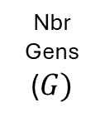
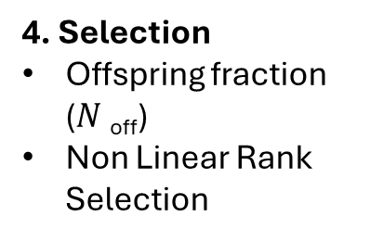
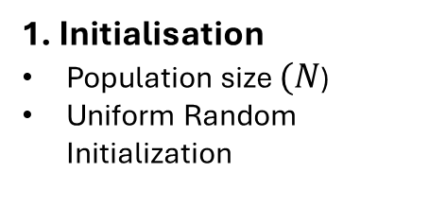

Genetic Algorithms library: openGA
2D Matrix: Caches ($C$) x Videos ($V$)
Vector: Used Capacity
Group B: Lang Thomas , Viale Jean-Jacques
1. Initialisation
Population size $(N$)
Uniform Random Initialization
3. Terminate Condition
Nbr of Generations
Stagnation detection
4. Selection
Offspring fraction ($N$_{off})
Non Linear Rank Selection
2. Evaluation
Objective Function 𝐹 given by Problem
Nbr Gens
($G)$
5. Crossover
Uniform Coin-flip
7. Selection
Elitism
Rank Based Selection
6. Mutation
Mutation Prob.
Single Bit-Flip
$$𝒪(\left(N+G ∗Noff) ∗(E ∗V ∗C)\right)$$

